Slide 1
Carbon storage in trees in relation to climate
Jennifer Salazar; Kiyomi Morino, PhD; Malcolm Hughes, PhD
The Laboratory of Tree-Ring Research, University of Arizona, Tucson, Arizona, USA
Arizona/NASA Space Grant Symposium, 2016

Slide 2

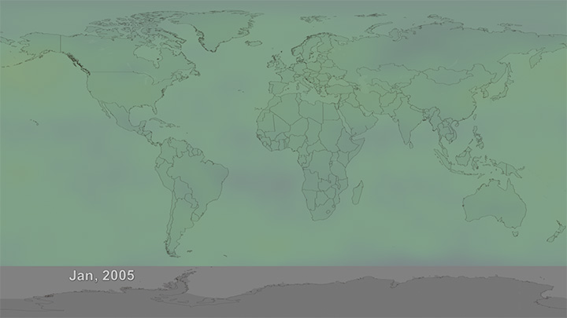
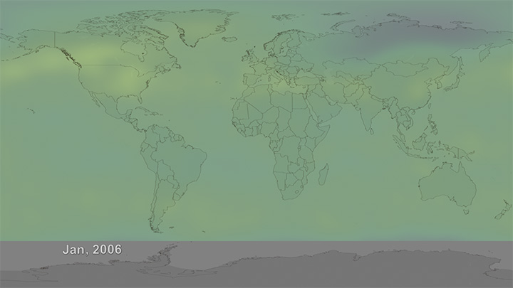
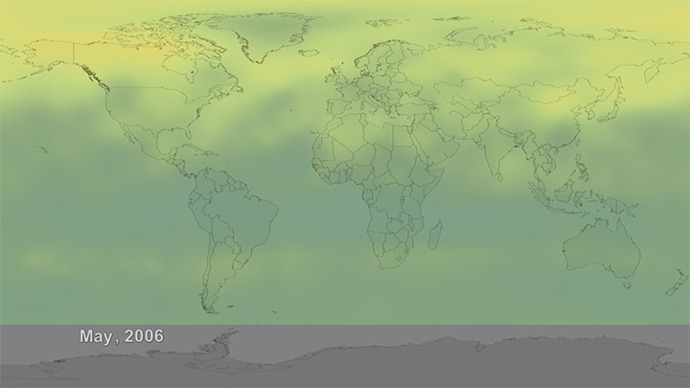
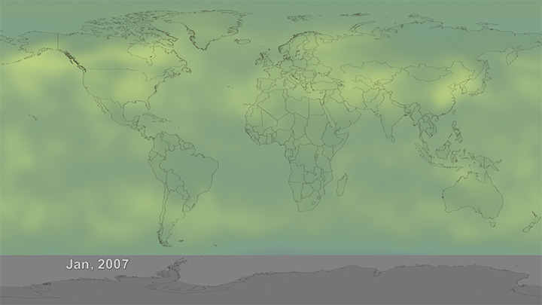
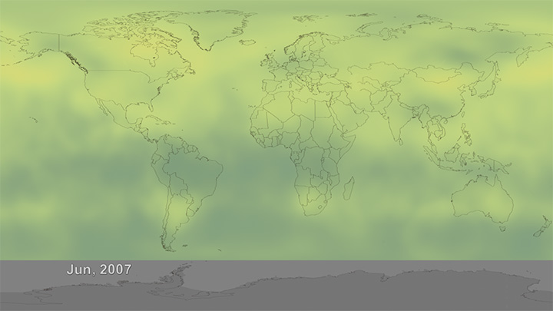
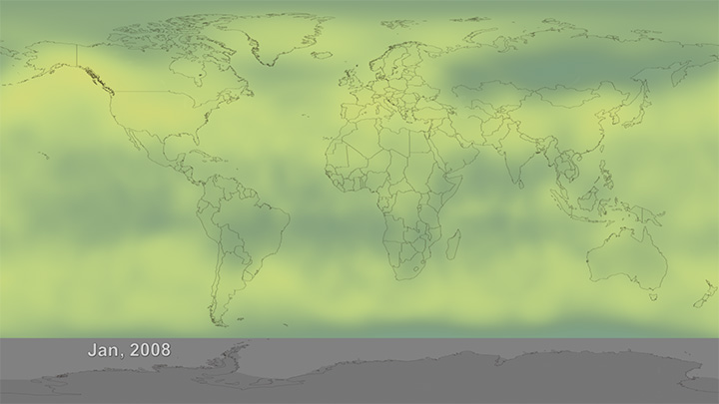
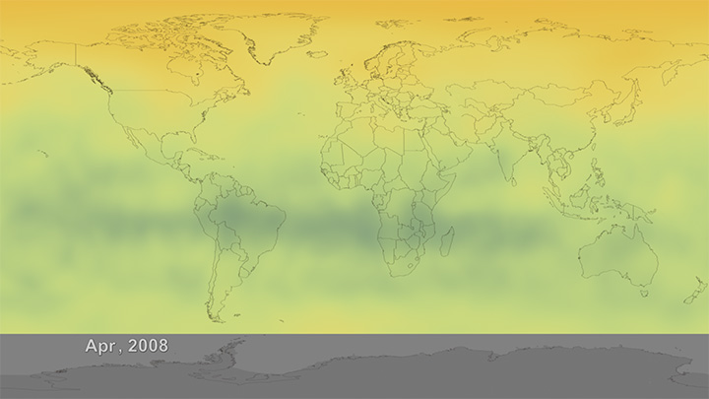
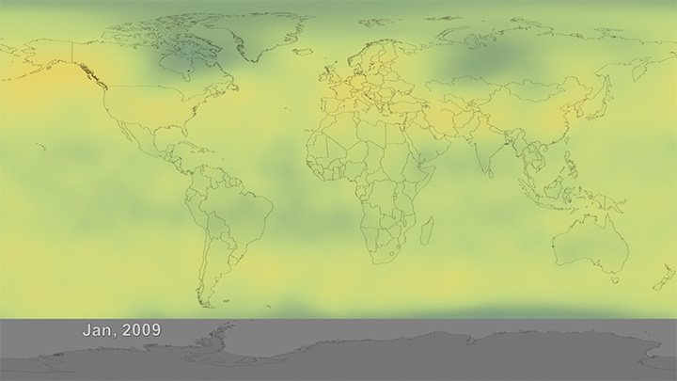
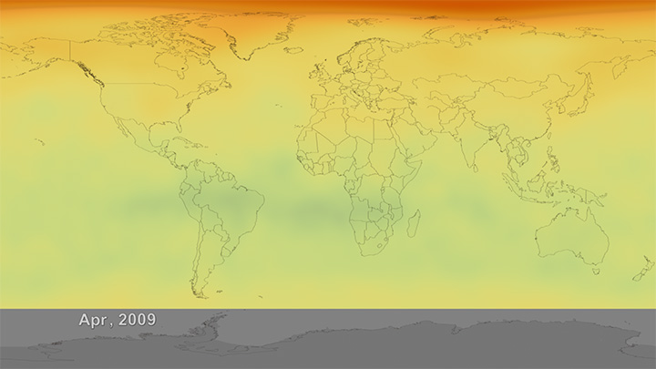
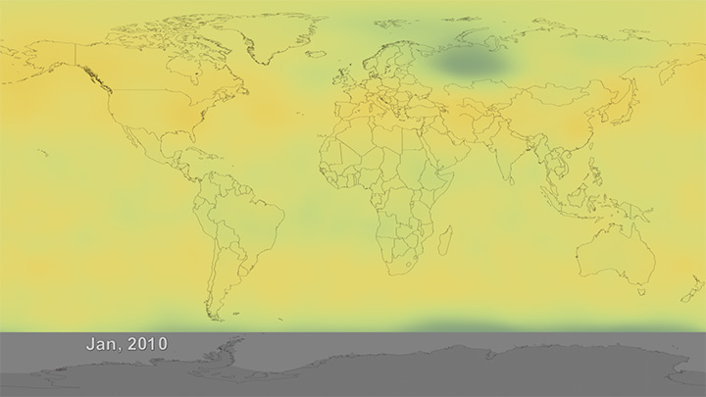
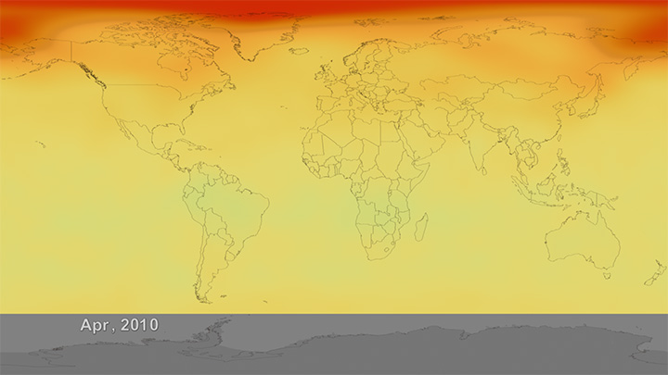
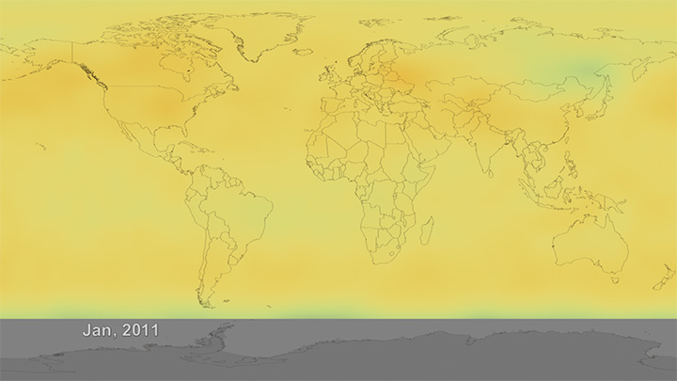
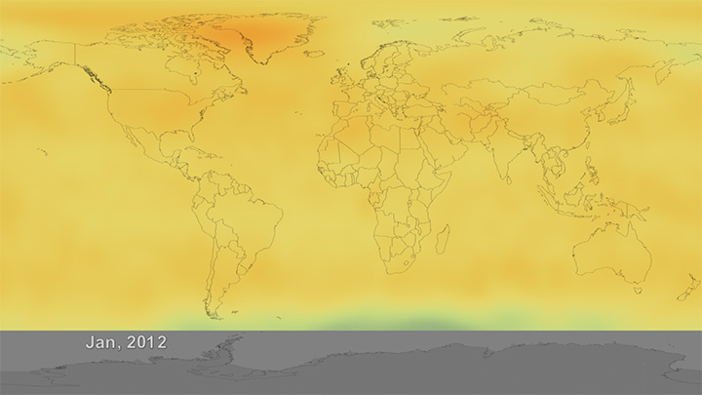
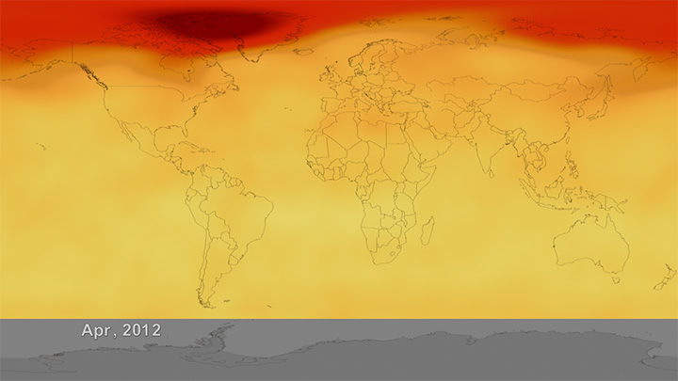
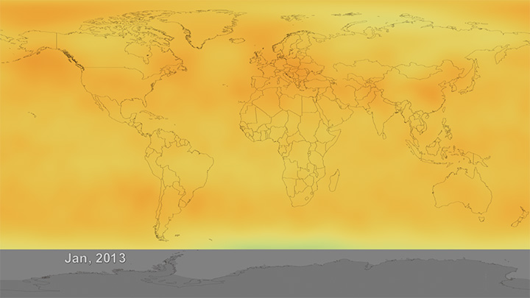
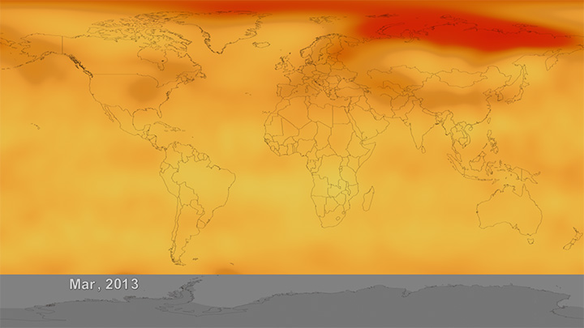
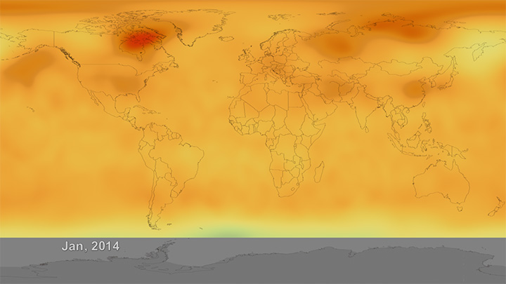
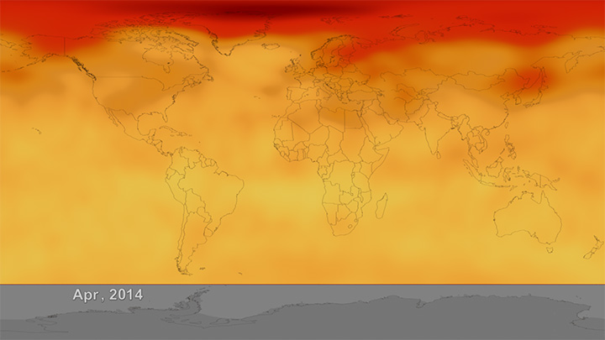
Jan 2005 – APR 2014
Notes:
TIME SERIES: 2005-2014
Data source: Atmospheric Infrared Sounder (AIRS).
Credit: NASA
If you have turned on the TV, you would know that increasing levels of carbon dioxide in the atmosphere, have become a matter of considerable interest and concern.
This is because carbon dioxide is a heat-trapping gas, responsible for global warming and variously predictable climatic conditions.

Slide 3
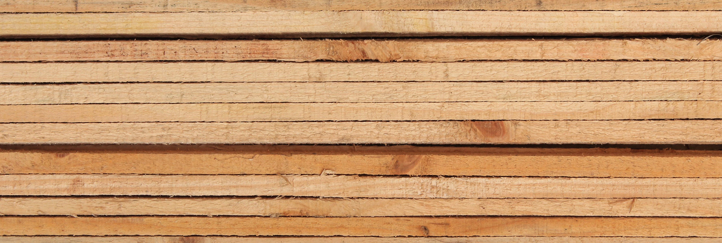
Forests are critical to the GLOBAL CARBON CYCLE
1/2
…the dry weight of wood is carbon.
Notes:
This means that forests could be used for carbon sequestration.
In other words, forests can be the means to offsetting greenhouse gas emissions and mitigating climate change.

Slide 4

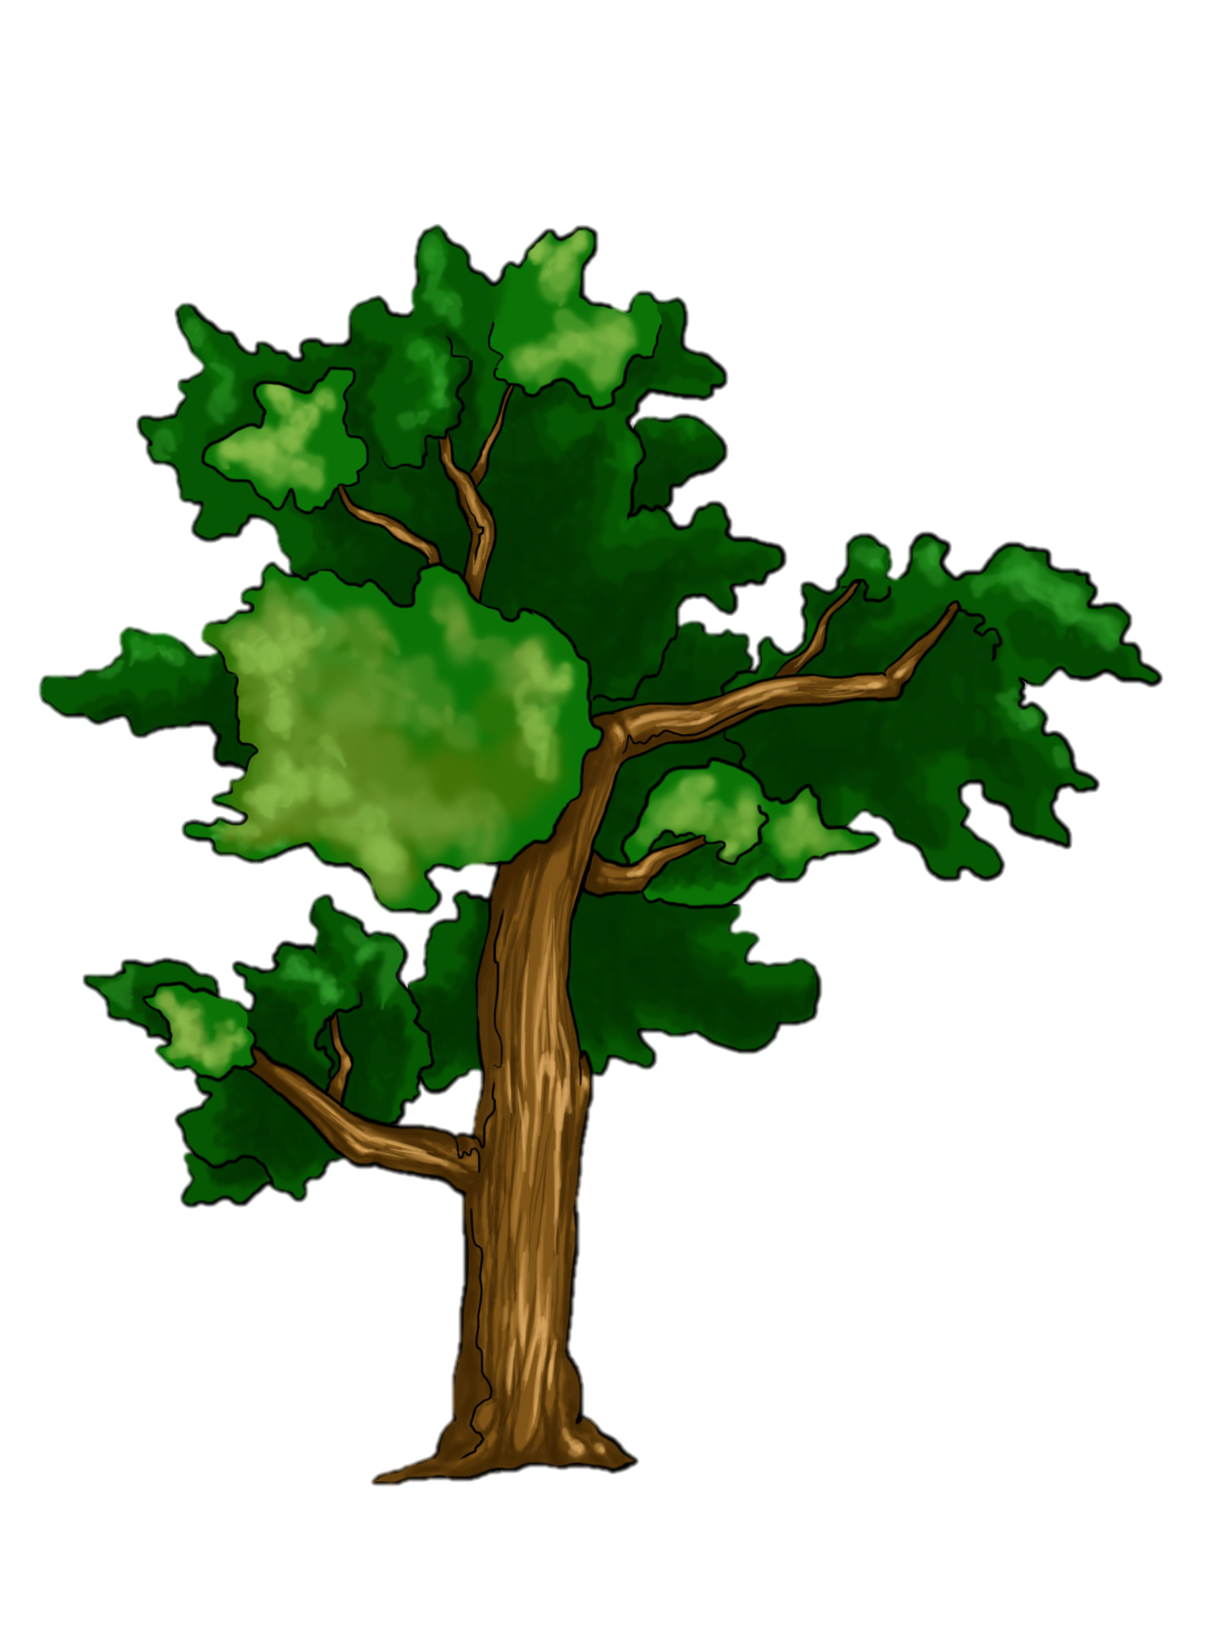
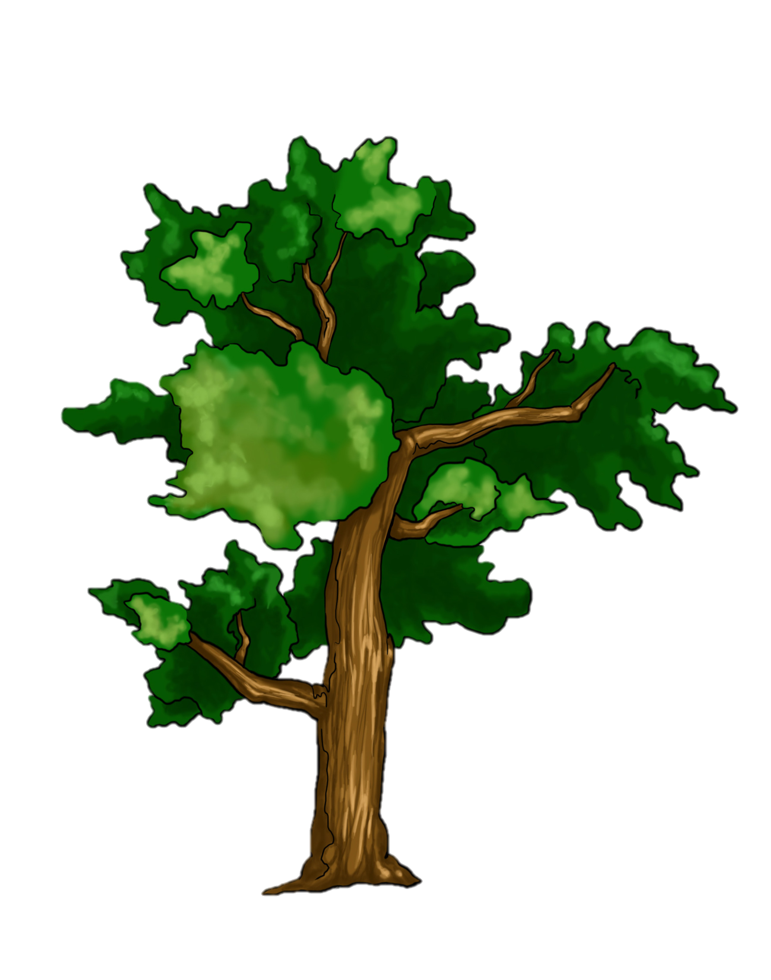
Atmosphere
Notes:
Growing trees absorb carbon from the atmosphere; it is allocated in the cells walls.
Carbon is released during deforestation and burning. When carbon is released, it reacts with oxygen to form carbon dioxide.
Wood products act as a temporary carbon sink, and can substitute for fossil fuels.
Carbon sink: more carbon absorbed than released.

Slide 5
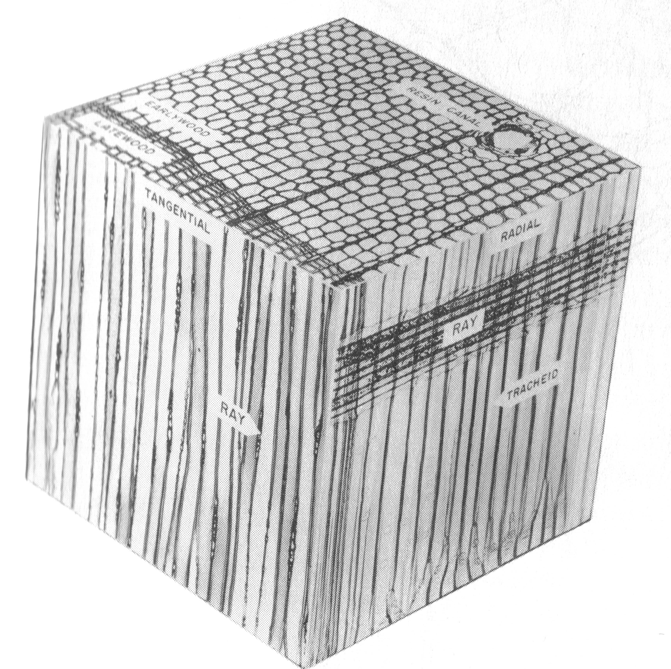

Slide 6
Does the amount of cell-wall area vary? What factors explain this?
Notes:
Knowing that carbon is stored in the cell-walls of trees, we asked this.
The purpose for this research was to characterize intra- and inter-annual variation of carbon storage in trees and its relation to climatic variability.

Slide 7
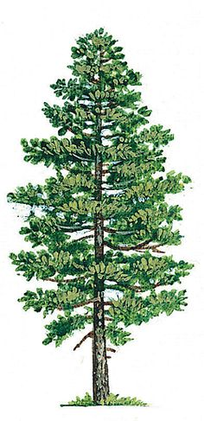
Approach in the field
215
216
218
220
Mt. bigelow, 2010 - 2014

Slide 8
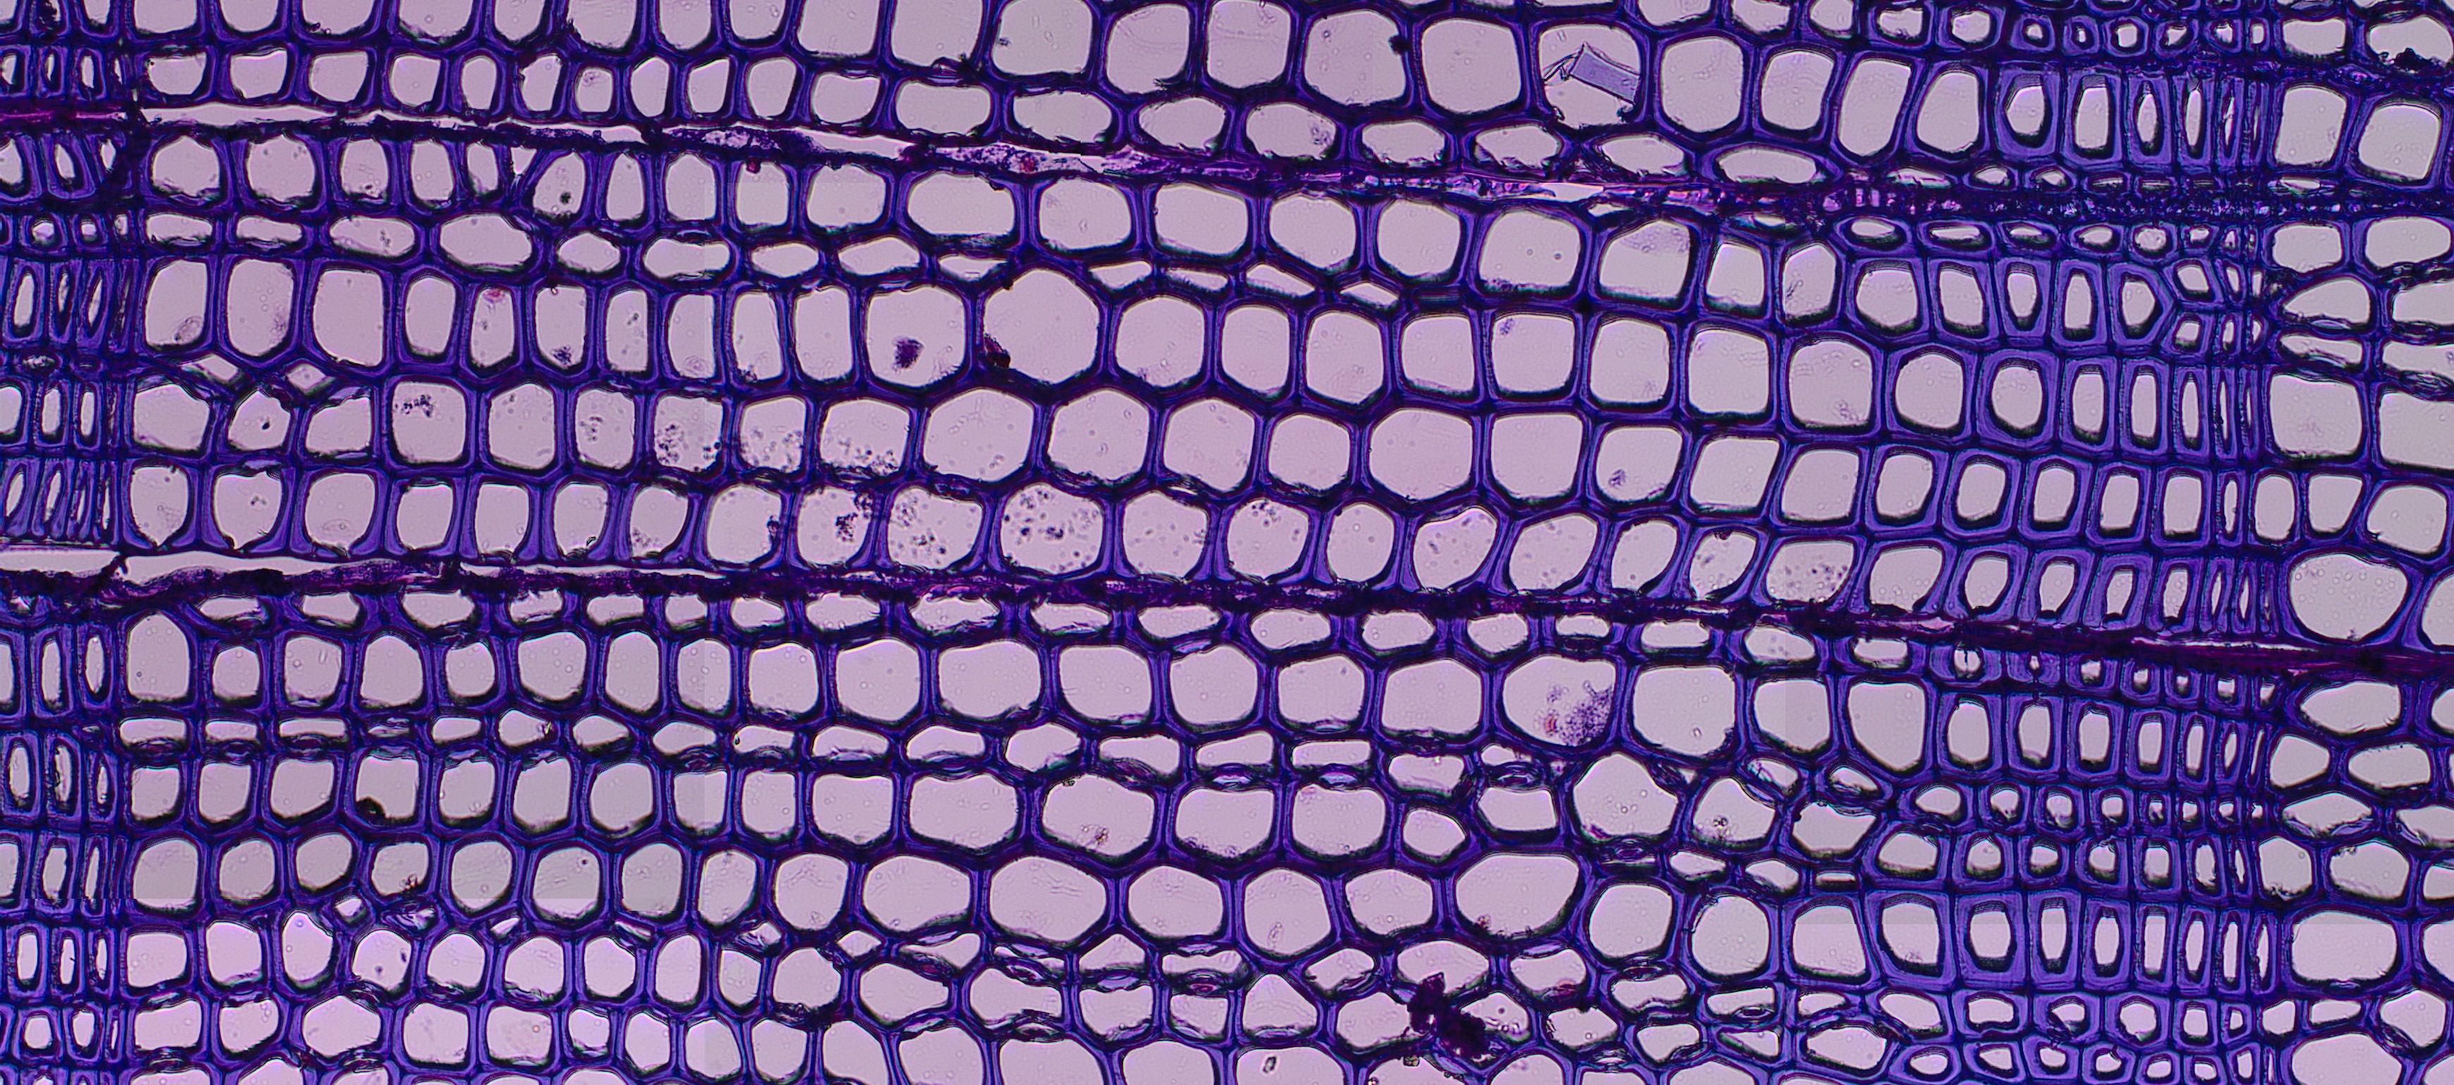
From field to lab
ANNUAL RING 2011

Slide 9
From field to lab
ANNUAL RING 2011
EARLY WOOD (EW)
LATE WOOD (LW)

Slide 10
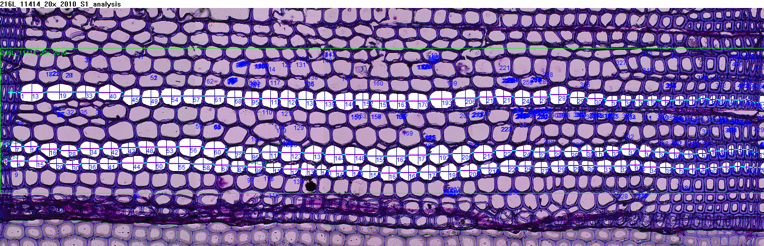
Data Analysis

Slide 11
findings
Winter PRCP
CELL-WALL AREA (mm²)
CELL-WALL AREA (mm²)
YEAR
YEAR

Slide 12
findings
Winter PRCP
CELL-WALL AREA (mm²)
CELL-WALL AREA (mm²)
YEAR
YEAR

Slide 13

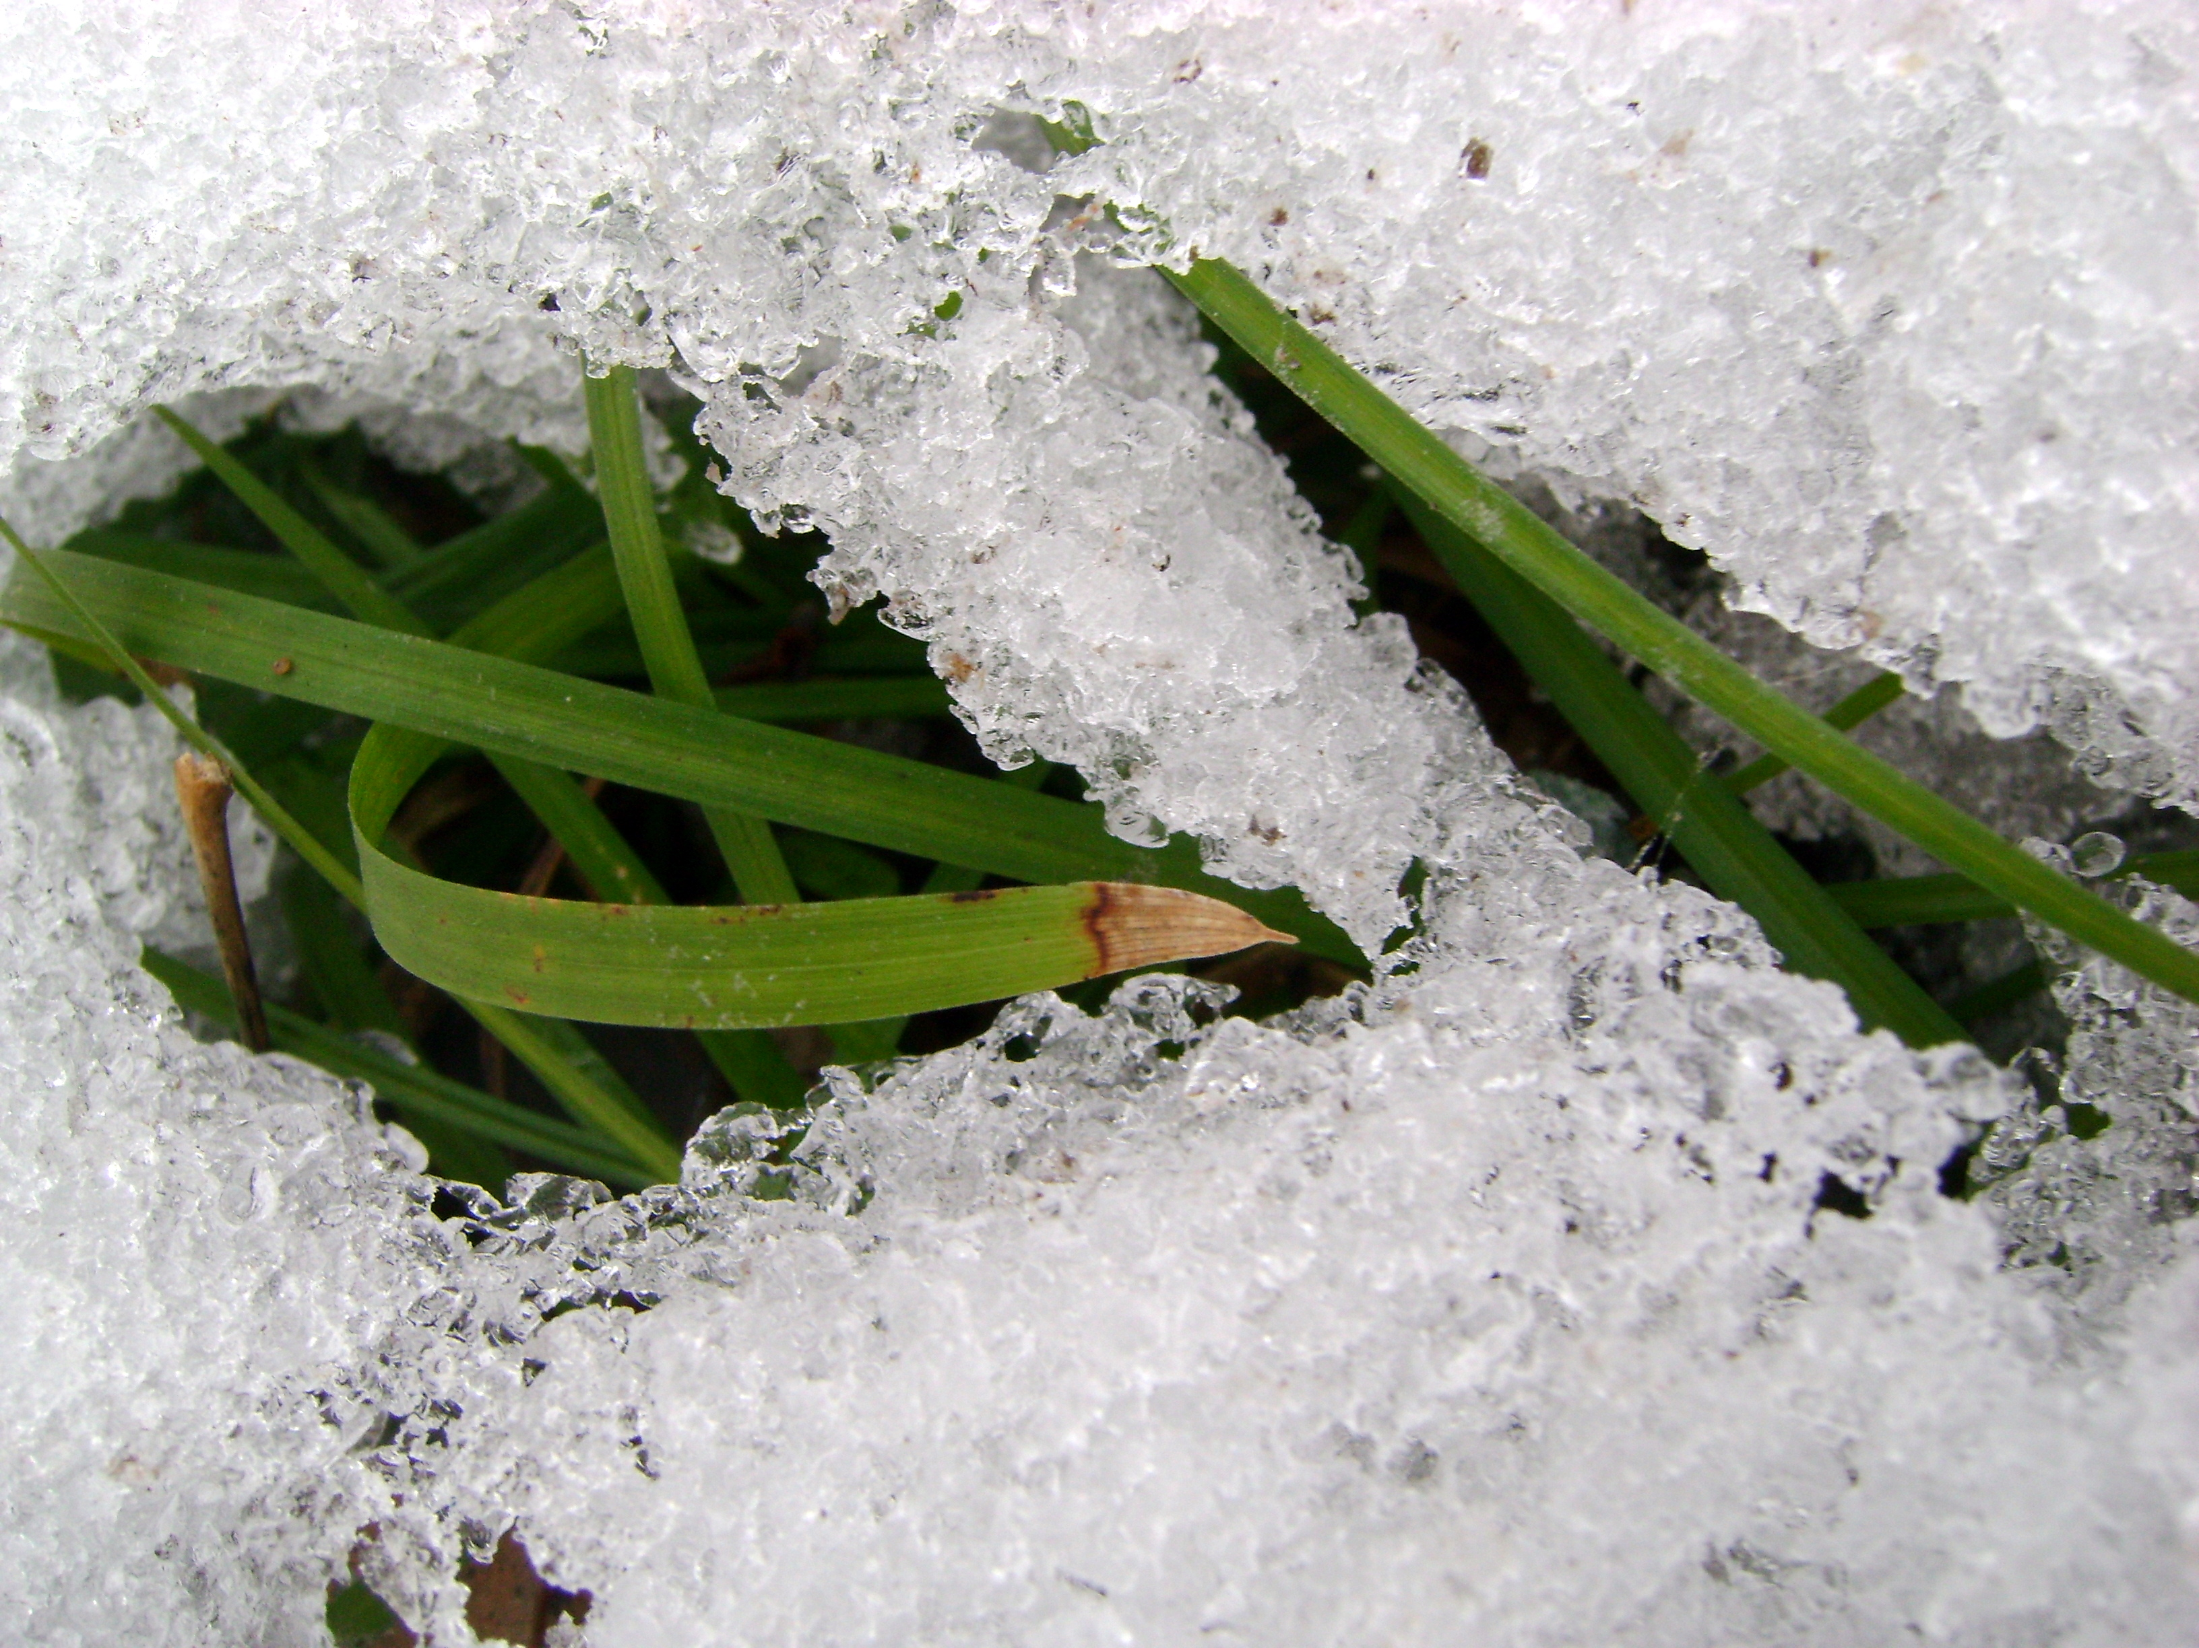
Mar. 2012
Mar. 2013

Slide 14
Conclusions
«Must refine methods for processing.
«In trees, cell-wall area does vary based on seasonality.
«Factors that influence carbon allocation include climatic conditions, like precipitation.
«Forests are an important carbon sink, given there is water available.

Slide 15
Thank You.

Slide 16



